Slide 1
DMOJ
Week 1

Slide 2
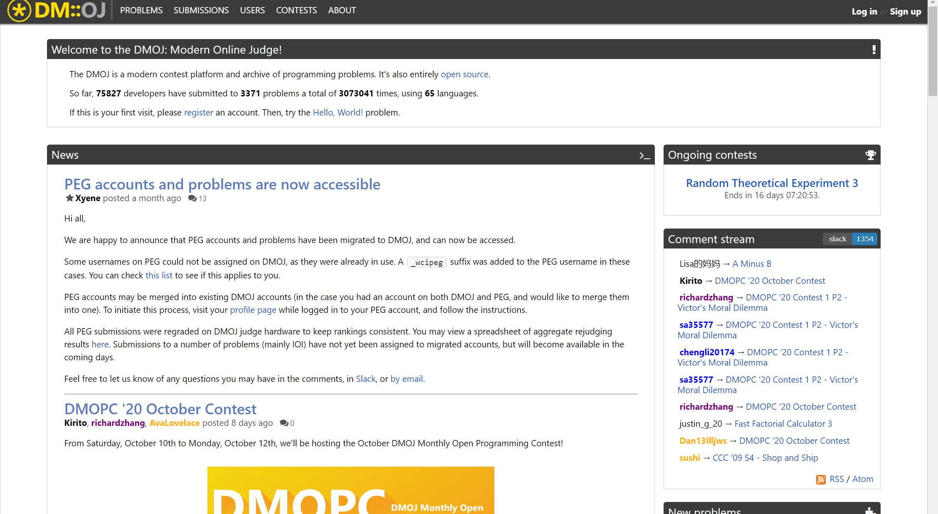
Setting up DMOJ
Go to https://dmoj.ca/
Press the top “Sign up” button at the top right
Enter your account information and register

Slide 3
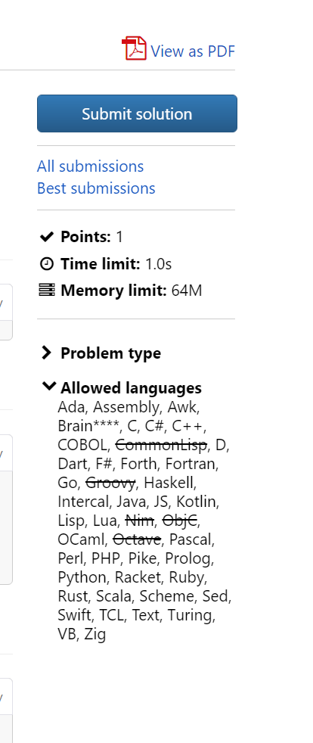
Submitting An Answer
Go to the problem “Hello World!” https://dmoj.ca/problem/helloworld
Click the “Submit solution” button
Select the language the code is written in at the bottom right and submit

Slide 4
Understanding Status Codes
AC : You got the answer right
WA : The output of the code did not match the answer
IR or RTE: The program crashed
OLE : Too much data was outputted
MLE : You used too much memory
TLE : Ran out of time, your program is too inefficient

Slide 5
Bubble Sort
Description
A sorting algorithm that works by repeatedly swapping the adjacent elements if they are in the wrong order
if (array[i] > array[i+1]) → swap them
Continuously apply this approach until you reach the end of the list of numbers
If the array is still not sorted, return to the first number of the list and repeat the entire process over again
You will be able to know if the array is sorted or not depending on if you need to swap two adjacent numbers
Time Complexity:
O(n²) worst case scenario, O(n) best case scenario

Slide 6
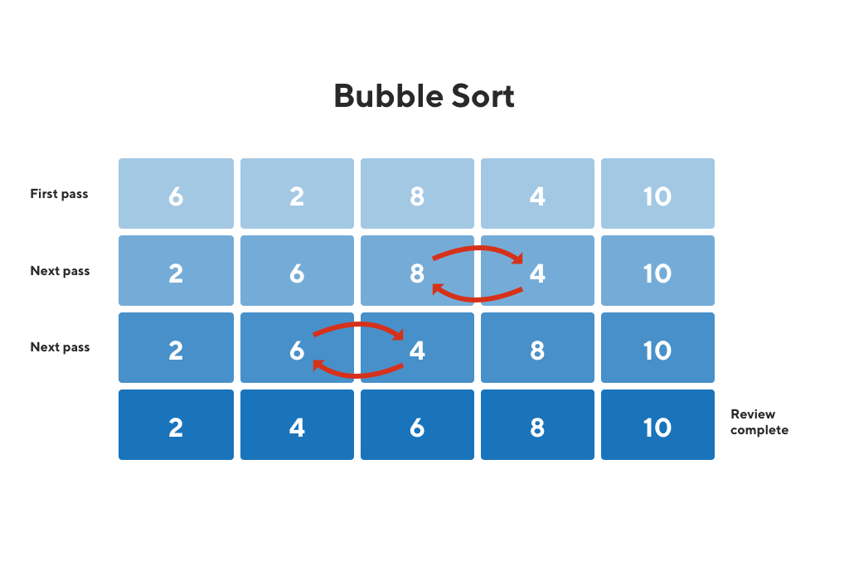
Example of Bubble Sort

Slide 7
Merge Sort - A better sort
Description
Recursive sort
Divide the array into 2 smaller arrays at their midpoint
Continuously divide arrays into subarrays until the array is of length 1, then it is indivisible
When you backtrack, call the merge function on the two halves of the subarray
Merge function
Takes in two sorted arrays and gets the union of them that is sorted
Since both arrays are sorted, you can get the sorted union in O(n) time
Time complexity
Splitting the array takes O(logn) time
Merging takes O(n) time
Merge sort takes O(nlogn) time

Slide 8
Implements Comparable Interface
When making custom classes that need to be sorted, you can implement the Comparable interface to indicate what variable should be sorted
Inside the class, you must create the method:
public void compareTo(Object o)
Inside the method, you can then indicate how you would like to sort the variable in your class
Usually, you would include:
return this.variable - o.variable;

Slide 9
Example of Comparable Interface
class Pair implements Comparable<Pair>{
int a, b;
Pair(int a, int b){
this.a = a;
this.b = b;
}
public void compareTo(Pair p){
return this.b - p.b;
}
}
In main method, you have Pair[] array = new Pair[n];
Arrays.sort(array) will sort by the value of the variable ‘b’

Slide 10
Sorting In Python, Java, C++
Python: https://www.w3schools.com/python/ref_list_sort.asp
C++: http://www.cplusplus.com/reference/algorithm/sort/
Java: https://www.geeksforgeeks.org/arrays-sort-in-java-with-examples/

Slide 11
Problems
https://dmoj.ca/problem/bf1easy
https://dmoj.ca/problem/sort1
https://dmoj.ca/problem/a4b1
https://dmoj.ca/problem/dmopc18c1p1
https://dmoj.ca/problem/ccc12s3

